Slide 1
RIP version 1
Routing Protocols and Concepts – Chapter 5

Slide 2
Objectives
Describe the functions, characteristics, and operation of the RIPv1 protocol.
Configure a device for using RIPv1.
Verify proper RIPv1 operation.
Describe how RIPv1 performs automatic summarization.
Configure, verify, and troubleshoot default routes propagated in a routed network implementing RIPv1.
Use recommended techniques to solve problems related to RIPv1

Slide 3
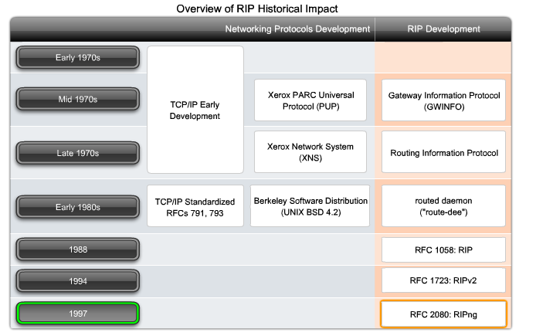
Historical Development

Slide 4
RIPv1
RIP Characteristics
-A classful, Distance Vector (DV) routing protocol
-Metric = hop count
-Routes with a hop count > 15 are unreachable
-Updates are broadcast every 30 seconds

Slide 5
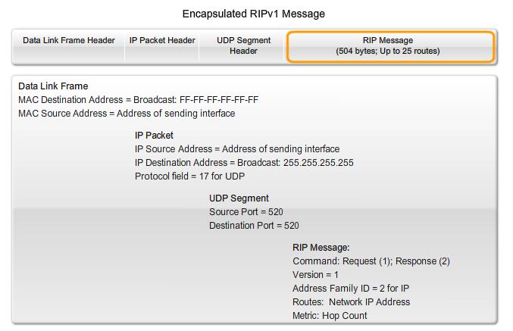
RIPv1 Message Details

Slide 6
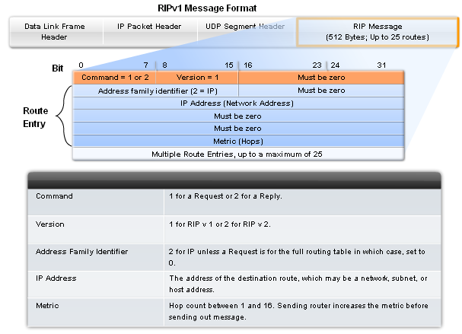
RIPv1
RIP Message Format
RIP header - divided into 3 fields
-Command field
-Version field
-Must be zero (specified room for future expansion of this protocol)
Route Entry - composed of 3 fields
  -Address family identifier
  -IP address
  -Metric

Slide 7
Why so many fields set to Zero?
Why are there so many fields set to zero?
RIP was developed before IP and was used for other network protocols (like XNS).
BSD also had its influence. Initially, the extra space was added with the intention of supporting larger address spaces in the future.
As we will see in Chapter 7, RIPv2 has now used most of these empty fields.

Slide 8
RIPv1
RIP Operation
  RIP uses 2 message types:
      Request message
-This is sent out on startup by each RIP enabled interface
-Requests all RIP enabled neighbors to send routing table
      Response message
-Message sent to requesting router containing routing table

Slide 9
RIP Messages
Each RIP-configured interface sends out a request message on startup, requesting that all RIP neighbours send their complete routing tables.
A response message is sent back by RIP-enabled neighbours.
When the requesting router receives the responses, it evaluates each route entry. If a route entry is new, the receiving router installs the route in the routing table. If the route is already in the table, the existing entry is replaced if the new entry has a better hop count.
The start-up router then sends a triggered update out all RIP-enabled interfaces containing its own routing table so that RIP neighbours can be informed of any new routes.

Slide 10
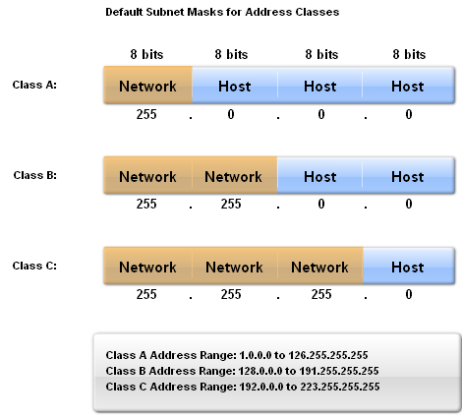
RIPv1
IP addresses initially divided into classes
-Class A
-Class B
-Class C
RIP is a classful routing protocol
-Does not send subnet masks in routing updates

Slide 11
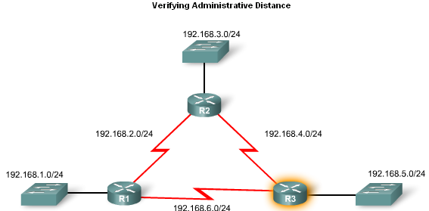
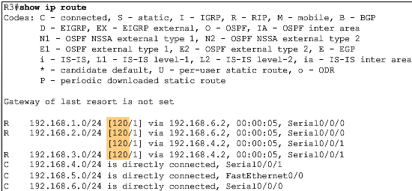
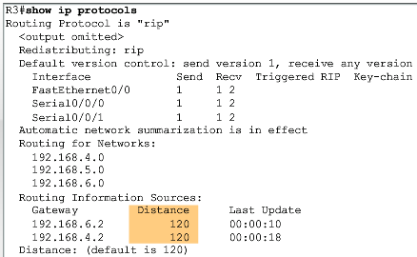
RIPv1
Administrative Distance
  RIP’s default administrative distance is 120

Slide 12
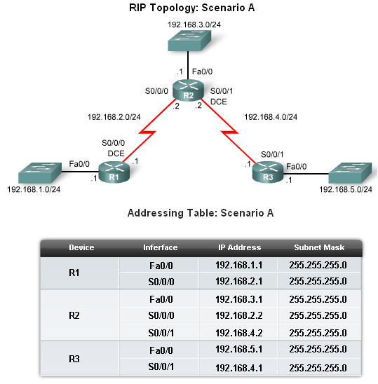
Basic RIPv1 Configuration
A typical topology suitable for use by RIPv1 includes:
    -Three router set up
    -No PCs attached to LANs
-Use of 5 different IP subnets

Slide 13
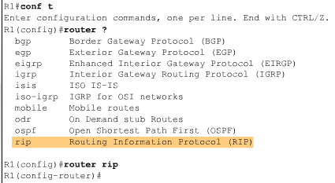
Basic RIPv1 Configuration
Router RIP Command
  To enable RIP enter:
  -Router rip at the global configuration prompt
  -Prompt will look like R1(config-router)#

Slide 14
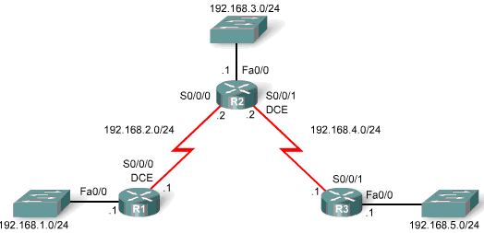
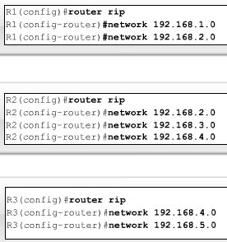
Basic RIPv1 Configuration
Specifying Networks
  Use the network command to:
  -Enable RIP on all interfaces that belong to this network
  -Advertise this network in RIP updates sent to other routers every 30 seconds

Slide 15
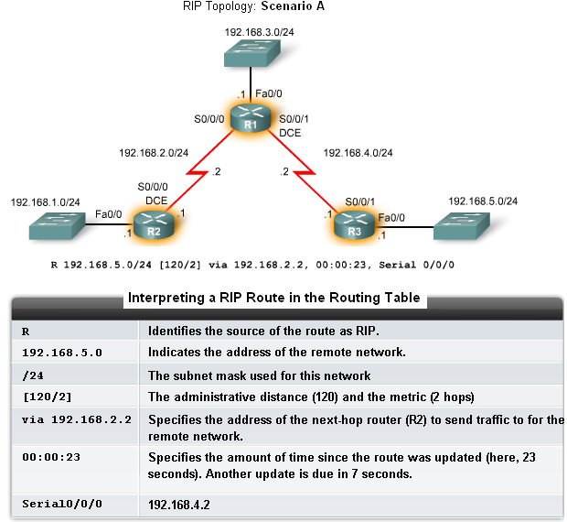
Verification and Troubleshooting
Show ip Route
To verify and troubleshoot routing
-Use the following
commands:
-show ip route
-show ip protocols
-debug ip rip

Slide 16
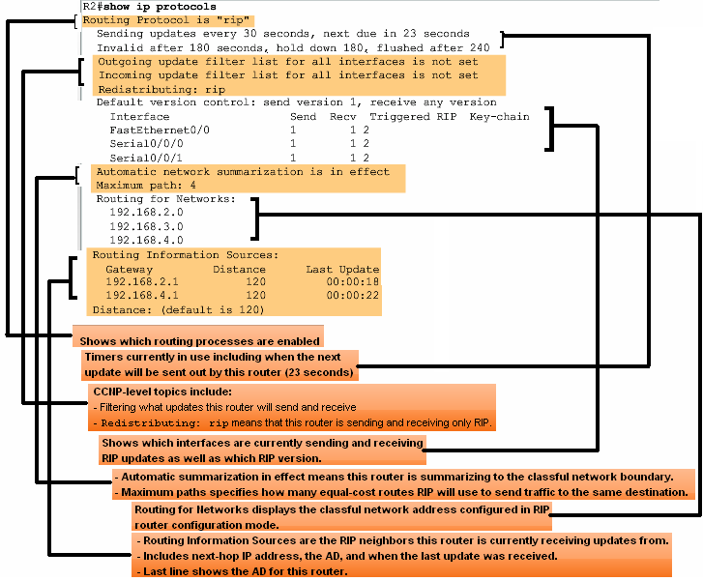
Verification and Troubleshooting
show ip protocols command
-Displays routing protocol configured on router

Slide 17
Show IP Protocols
If a network is missing from the routing table, check the routing configuration using show ip protocols. The show ip protocols command displays the routing protocol that is currently configured on the router. This output can be used to verify most RIP parameters to confirm that:
RIP routing is configured
The correct interfaces send and receive RIP updates
The router advertises the correct networks
RIP neighbors are sending updates
This command is also very useful when verifying the operations of other routing protocols, as we will see later with EIGRP and OSPF.

Slide 18
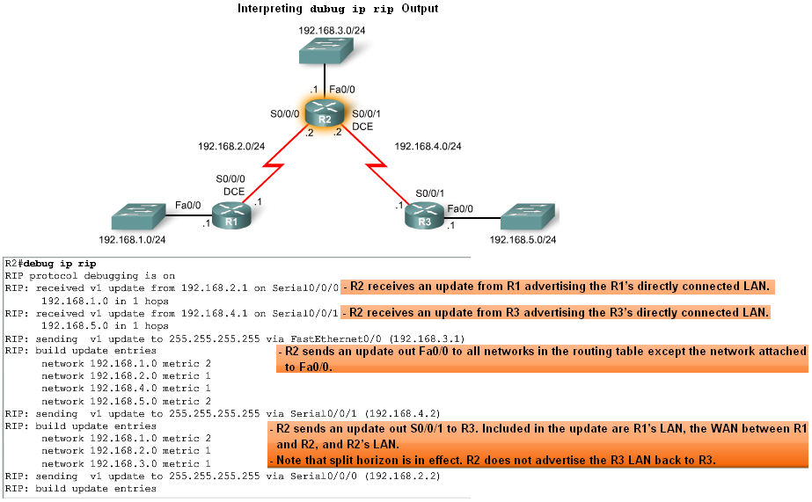
Verification and Troubleshooting
Debug ip rip command
-Used to display RIP routing updates as they are happening

Slide 19
Verification and Troubleshooting
Passive interface command
-Used to prevent a router from sending updates through an interface
-Example:
Router(config-router)#passive-interface interface-type interface-number
This command stops routing updates out the specified interface. However, the network that the specified interface belongs to will still be advertised in routing updates that are sent out other interfaces.

Slide 20
Unnecessary Updates
R2 is sending updates out FastEthernet0/0 even though no RIP device exists on that LAN. R2 has no way of knowing this and, as a result, sends an update every 30 seconds. Sending out unneeded updates on a LAN impacts the network in three ways:
Bandwidth is wasted transporting unnecessary updates. Because RIP updates are broadcast, switches will forward the updates out all ports.
All devices on the LAN must process the update up to the Transport layers, where the receiving device will discard the update.
Advertising updates on a broadcast network is a security risk. RIP updates can be intercepted with packet sniffing software. Routing updates can be modified and sent back to the router, corrupting the routing table with false metrics that misdirect traffic.

Slide 21
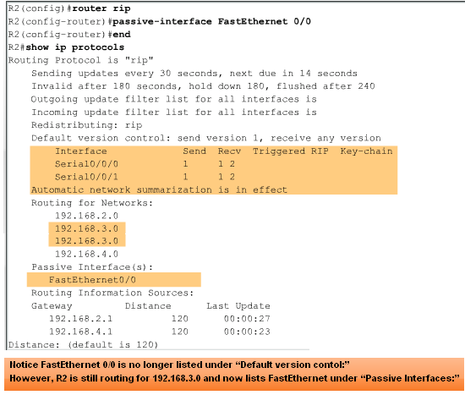
Verification and Troubleshooting
Passive interfaces

Slide 22
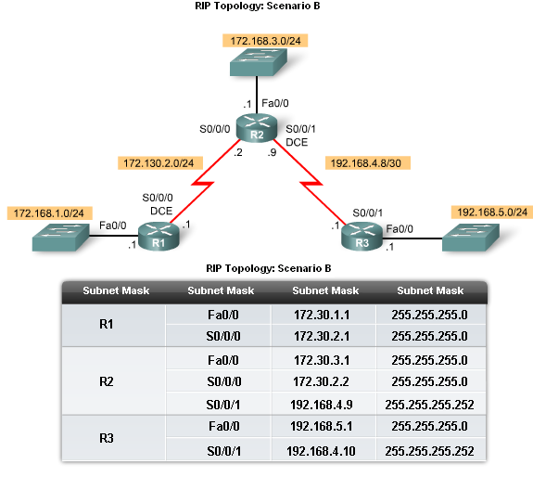
Automatic Summarization
Modified Topology
The original scenario has been modified such that:
Three classful networks are used:
172.30.0.0/16
192.168.4.0/24
192.168.5.0/24
The 172.30.0.0/16 network is subnetted into three subnets:
172.30.1.0/24
172.30.2.0/24
172.30.3.0/24
The following devices are part of the 172.30.0.0/16 classful network address:
All interfaces on R1
S0/0/0 and Fa0/0 on R2

Slide 23
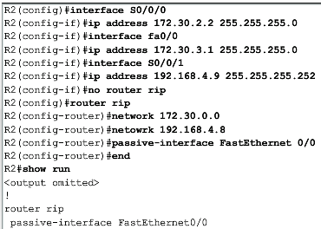
Automatic Summarization
Configuration Details
-To remove the RIP routing process use the following command
No router rip
-To check the configuration use the following command
Show run

Slide 24
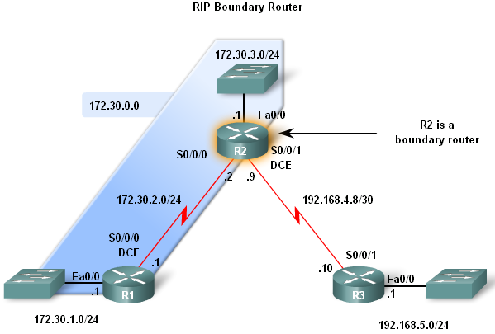
Automatic Summarization
Boundary Routers
  RIP automatically summarizes classful networks
  Boundary routers summarize RIP subnets from one major network to another.

Slide 25
Boundary Routers
RIP is a classful routing protocol that automatically summarizes classful networks across major network boundaries.
In the figure, you can see that R2 has interfaces in more than one major classful network. This makes R2 a boundary router in RIP. Serial 0/0/0 and FastEthernet 0/0 interfaces on R2 are both inside the 172.30.0.0 boundary.
The Serial 0/0/1 interface is inside the 192.168.4.0 boundary.
Because boundary routers summarize RIP subnets from one major network to the other, updates for the 172.30.1.0, 172.30.2.0 and 172.30.3.0 networks will automatically be summarized into 172.30.0.0 when sent out R2's Serial 0/0/1 interface.

Slide 26
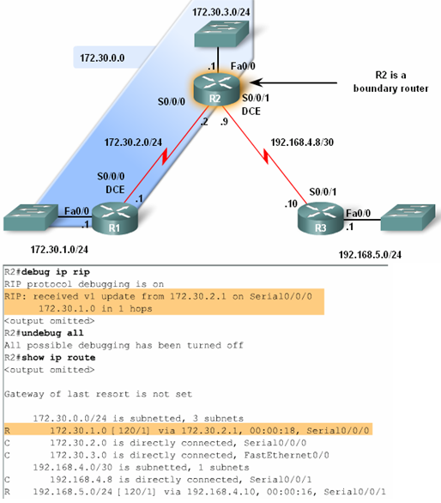
Automatic Summarization
Processing RIP Updates
2 rules govern RIPv1 updates:
-If a routing update and the interface it’s received on belong to the same network then
The subnet mask of the interface is applied to the network in the routing update
-If a routing update and the interface it’s received on belong to a different network then
The classful subnet mask of the network is applied to the network in the routing update.

Slide 27
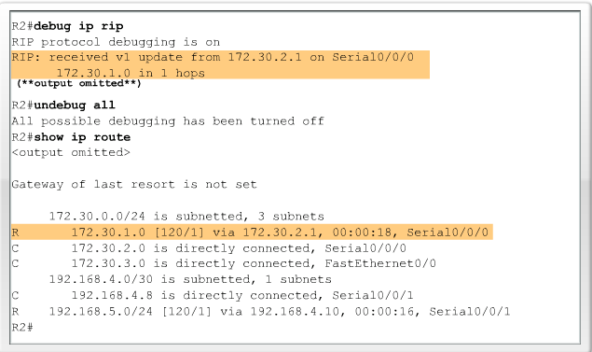
Example

Slide 28
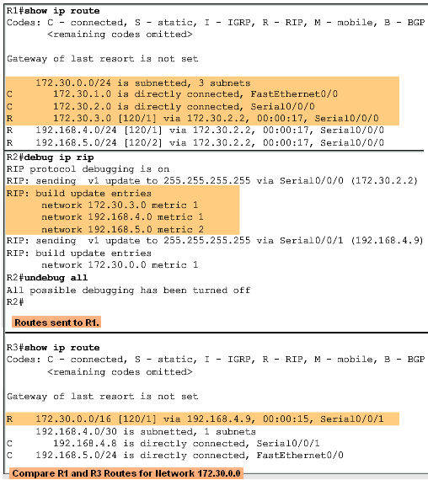
Automatic Summarization
Sending RIP Updates
  RIP uses automatic summarization to reduce the size of a routing table.

Slide 29
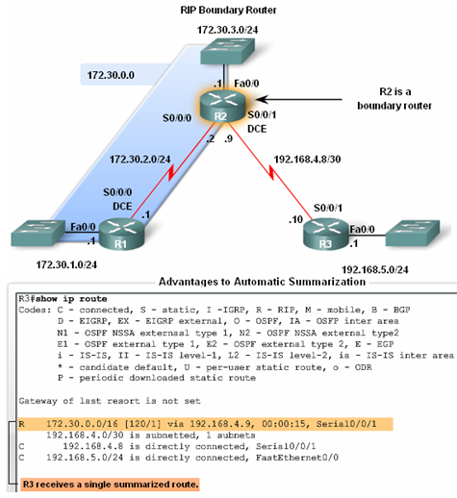
Automatic Summarization
Advantages of automatic summarization:
-The size of routing updates is reduced
-Single routes are used to represent multiple routes which results in faster lookup in the routing table.

Slide 30
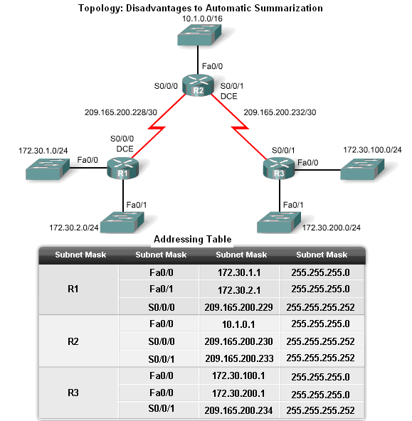
Automatic Summarization
Disadvantage of Automatic Summarization:
-Does not support discontiguous networks

Slide 31
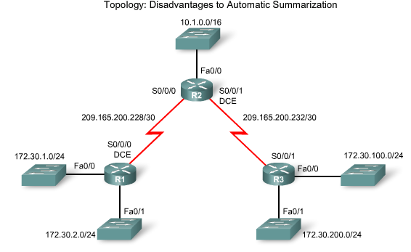
Example

Slide 32
Discontiguous Networks
Classful routing protocols do not include the subnet mask in routing updates.
Networks are automatically summarized across major network boundaries since the receiving router in unable to determine the mask of the route.
This is because the receiving interface may have a different mask than the subnetted routes.
Notice that R1 and R3 both have subnets from the 172.30.0.0/16 major network, whereas R2 does not.
Essentially, R1 and R3 are boundary routers for 172.30.0.0/16 because they are separated by another major network, 209.165.200.0/24.
This separation creates a discontiguous network, as two groups of 172.30.0.0/24 subnets are separated by at least one other major network. 172.30.0.0/16 is a discontiguous network.

Slide 33
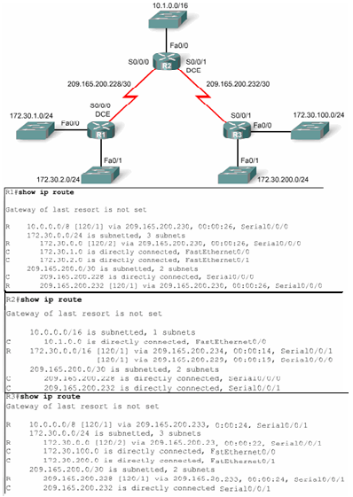
Automatic Summarization
Discontiguous Topologies do not converge with RIPv1
A router will only advertise major network addresses out interfaces that do not belong to the advertised route.

Slide 34
Default Route and RIPv1
Modified Topology: Scenario C
Default routes
  Packets that are not defined specifically in a routing table will go to the specified interface for the default route
  Example: Customer routers use default routes to connect to an ISP router.
  Command used to configure a default route is
  ip route 0.0.0.0 0.0.0.0 s0/0/1

Slide 35
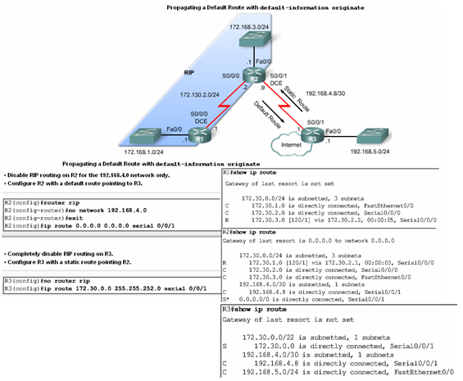
Default Route and RIPv1

Slide 36
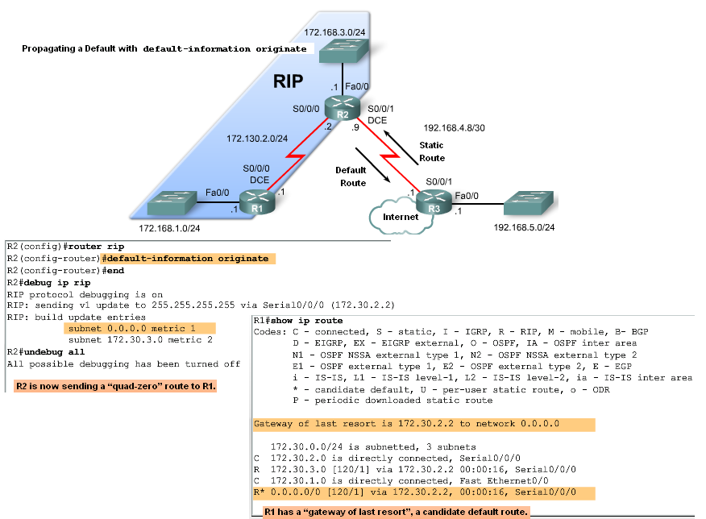
Default Route and RIPv1
Propagating the Default Route in RIPv1
Default-information originate command
  -This command is used to specify that the router is to originate default information, by propagating the static default route in RIP update.

Slide 37
Summary
RIP characteristics include:
Classful, distance vector routing protocol
Metric is Hop Count
Does not support VLSM or discontiguous subnets
Updates every 30 seconds
Rip messages are encapsulated in a UDP segment with source and destination ports of 520

Slide 38
Summary: Commands used by RIP
Command | Command’s purpose
Rtr(config)#router rip | Enables RIP routing process
Rtr(config-router)#network | Associates a network with a RIP routing process
Rtr#debug ip rip | used to view real time RIP routing updates
Rtr(config-router)#passive-interface fa0/0 | Prevent RIP updates from going out an interface
Rtr(config-router)#default-information originate | Used by RIP to propagate default routes
Rtr#show ip protocols | Used to display timers used by RIP

